Slide 1
Meet Hadoop & MapReduce
Chapter 1 and 2

Slide 2
Learning Objectives
The Apache Hadoop Project
Analyze a Weather Dataset
Hadoop Map and Reduce
Java MapReduce Programming
Map and Reduce Tasks

Slide 3
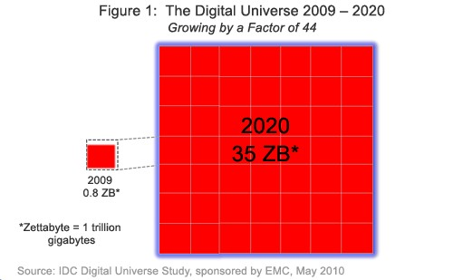
The Digital Universe
Digital Universe: the total amount of data stored in the world’s computers
Zettabyte: 10²¹ bytes >> Exabyte >> Petabyte >> Terabyte

Slide 4

Flood of Data – 1
NYSE generates 1TB new trade data / day

Slide 5

Flood of Data – 2
Facebook hosts 10 billion photos (1 petabyte)

Slide 6
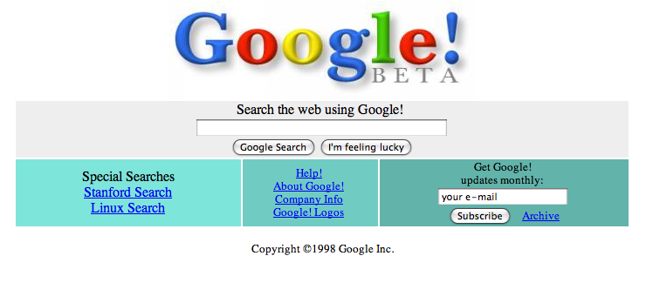
Flood of Data – 3
Google processed about 24 petabytes of data per day in 2009

Slide 7

Public Data
Available Public Data Sets on AWS
Annotated Human Genome
Public database of chemical structures
Various census data and labor statistics

Slide 8
History of Hadoop
Created by Doug Cutting
Originated in Apache Nutch (2002)
Open source web search engine, a part of the Lucene project
NDFS (Nutch Distributed File System, 2004)
MapReduce (2005)
Doug Cutting joins Yahoo! (Jan 2006)
Official start of Apache Hadoop project (Feb 2006)
Adoption of Hadoop on Yahoo! Grid team (Feb 2006)

Slide 9
The Apache Hadoop Project
Oozie
Sqoop
Hive
HBase
Pig
HDFS
Zoo Keeper
MapReduce
Avro
Notes:
PIG- HIVE are like SQL Code.

Slide 10
MapReduce
MapReduce is a programming model for parallel data processing.
Hadoop can run MapReduce programs written in various languages: e.g. Java, Ruby, Python, C++.
MapReduce comes into its own for large datasets.

Slide 11
Weather Dataset
Data from NCDC (National Climatic Data Center)
A large volume of log data collected by weather sensors: e.g. temperature
Data format
Line-oriented ASCII format
One line is one record
Each record has many elements
We focus on the temperature element
Data files are organized by date and weather station
There is a directory for each year from 1901 to 2001, each containing a gzipped file for each weather station with its readings for that year.

Slide 12
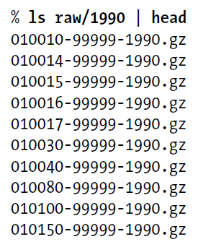
Analysis of Weather Dataset
The link to the dataset: ftp://ftp.ncdc.noaa.gov/pub/data/noaa/
What’s the highest recorded global temperature for each year in the dataset?
Year
Temperature
0067011990999991950051507004...9999999N9+00001+99999999999...
0043011990999991950051512004...9999999N9+00221+99999999999...
0043011990999991950051518004...9999999N9-00111+99999999999...
0043012650999991949032412004...0500001N9+01111+99999999999...
0043012650999991949032418004...0500001N9+00781+99999999999...
Contents of data files
List of data files

Slide 13
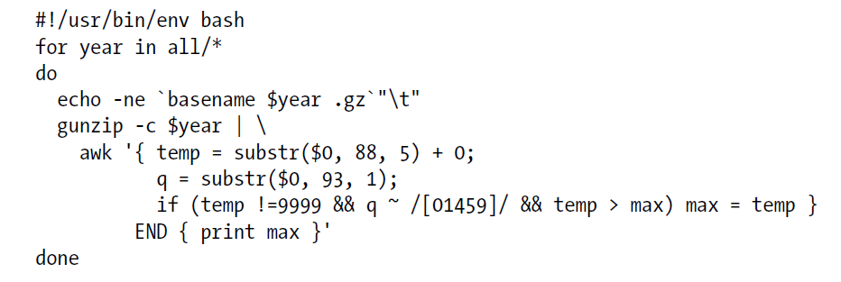
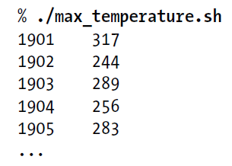
Analyzing the Data with Unix Tools
Use awk for processing line-oriented data.
Complete run for the century took 42 minutes on a single EC2 High-CPU Extra Large Instance.

Slide 14
Parallelize This Work
To speed up the processing, we need to run parts of the program in parallel.
Dividing the work
Process different years in different process.
It is important to divide the work into even distribution , i.e., split the input into fixed-size chunks.
Combining the results
Combination is more delicate when using fixed-size.
But still we are limited by the processing capacity of a single machine.
Some datasets grow beyond the capacity of a single machine.

Slide 15
Issues for Parallel Processing
To use multiple machines, we need to consider a variety of complex problems:
Coordination: Who runs the overall job?
Reliability: How do we deal with failed processes?
Hadoop can take care of these issues.

Slide 16
Hadoop MapReduce
To use MapReduce, we need to express out query as a MapReduce job.
A MapReduce job includes two phases: the Map phase and the Reduce phase.
Each phase has key-value pairs as input and output.
Programmer specifies the Map and Reduce functions and the types of input and output for them.

Slide 17
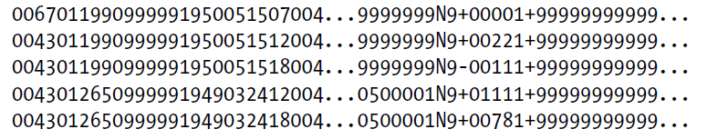
MapReduce Design of NCDC Example - 1
Map phase
Text input format of the dataset files
Key: offset of the line (unnecessary)
Value: each line of the files
Pull out the year and the temperature
The map phase is simply data preparation phase
Drop bad records (filtering)
Input File

Slide 18
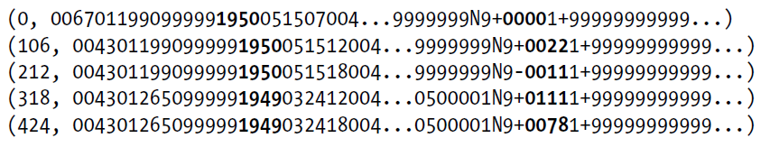
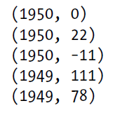
MapReduce Design of NCDC Example - 2
Input File
Input of Map Function (key, value)
Output of Map Function (key, value)
Map

Slide 19


MapReduce Design of NCDC Example - 3
The output from the map function is processed by Reduce function.
Sorts and groups the key-value pairs by key
Sort and Group By
Reduce function iterates through the list and pick up the maximum value
Reduce

Slide 20
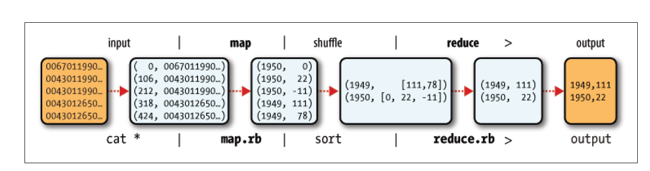
MapReduce Design of NCDC Example - 4

Slide 21
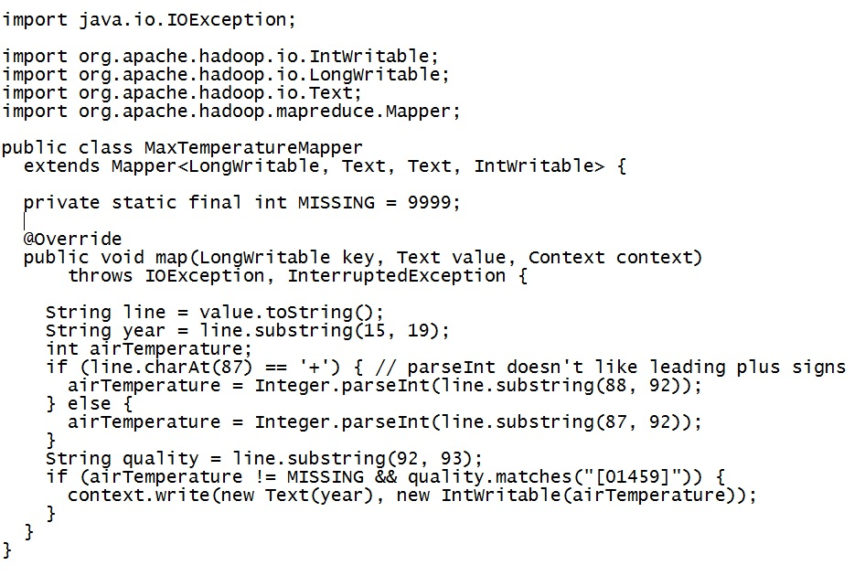
Java Implementation: Map
Map function implements the Mapper interface – generic type and four type parameters (input key, input value, output key, output value type).

Slide 22
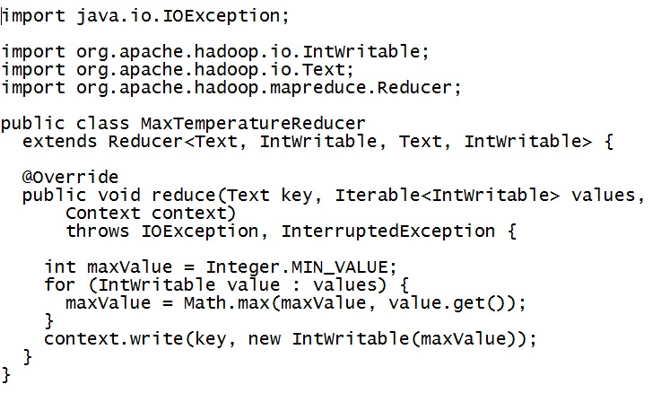
Java Implementation: Reduce
Reduce function implements the Reducer interface – generic type and four type parameters (input key, input value, output key, output value type)
Input types of the reduce function must match the output types of the map function: Text and IntWritable.

Slide 23
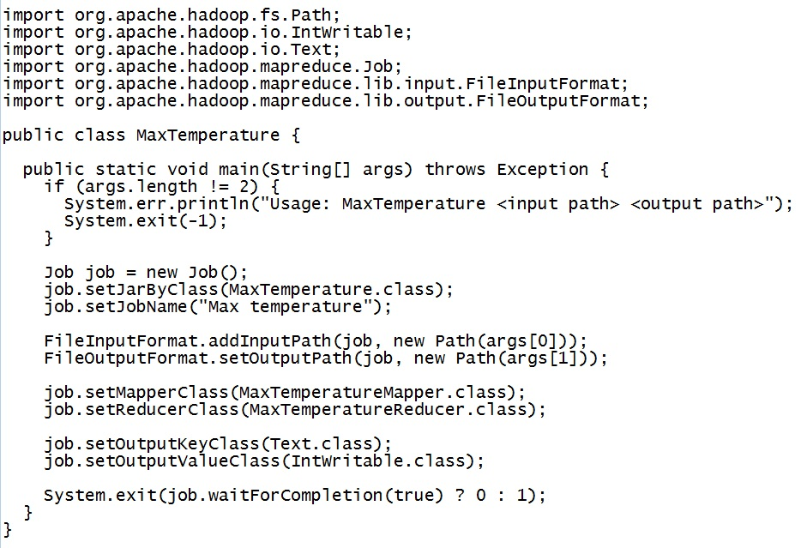
Java Implementation: Main - 1

Slide 24
Java Implementation: Main - 2
job.setJarByClass – code will be packaged into a JAR file; pass a class to the Job’s setJarByClass() method; Hadoop will locate the JAR file containing this class and distribute around the cluster.
addInputPath() & setOutputPath() – specify input and output paths; If the output directory exists before running the job, Hadoop will complain and not run the job.
setMapperClass() & setReducerClass – specify map and reduce types.
setOutputKeyClass() & setOutputValueClass() – control the output types for the map and the reduce functions, which are often the same.
Wait ForCompletion() – submits the job and waits for it to finish.

Slide 25
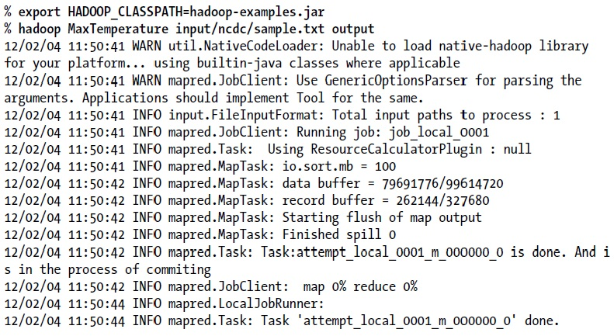
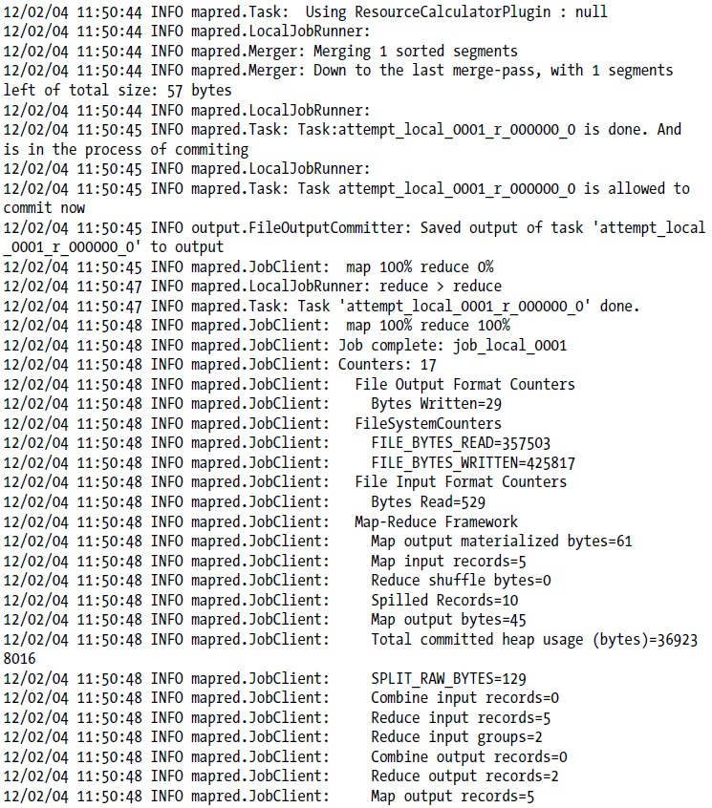
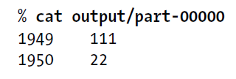
A Test Run
Output Log
Output Log (cont.)
Final Output

Slide 26
Jobtracker and Tasktracker
To scale out, we need to store the data in a distributed filesystem, HDFS (Chap. 3).
MapReduce job is divided into map tasks and reduce tasks.
Two types of nodes: Jobtracker and Tasktracker
Jobtracker coordinates all the jobs on the system by scheduling tasks to run on tasktrackers.
If a task fails, the jobtracker can reschedule it on a different tasktracker.
Tasktracker runs tasks and send progress reports to the jobtracker.

Slide 27
Input Splits
Divides input into fixed-size pieces – input splits
Hadoop creates one map task for each split.
Map task runs the user-defined map function for each record in the split.
Size of splits
Small size is better for load-balancing: faster machine will be able to process more splits.
But if splits are too small, the overhead of managing the splits dominate the total execution time.
For most jobs, a good split size tends to be the size of a HDFS block, 64MB (default).

Slide 28
Data Locality Optimization
Data locality optimization
Run the map task on a node where the input data resides in HDFS.
This is the reason why the split size is the same as the block size
The largest size of the input that can be guaranteed to be stored on a single node.
If the split spanned two blocks, it would be unlikely that any HDFS node stored both blocks.

Slide 29
How Map Tasks Write Output
Map tasks write their output to local disk (not to HDFS)
Map output is intermediate output.
Once the job is complete the map output can be thrown away.
So storing it in HDFS with replication, would be overkill.
If the node of map task fails, Hadoop will automatically rerun the map task on another node.

Slide 30
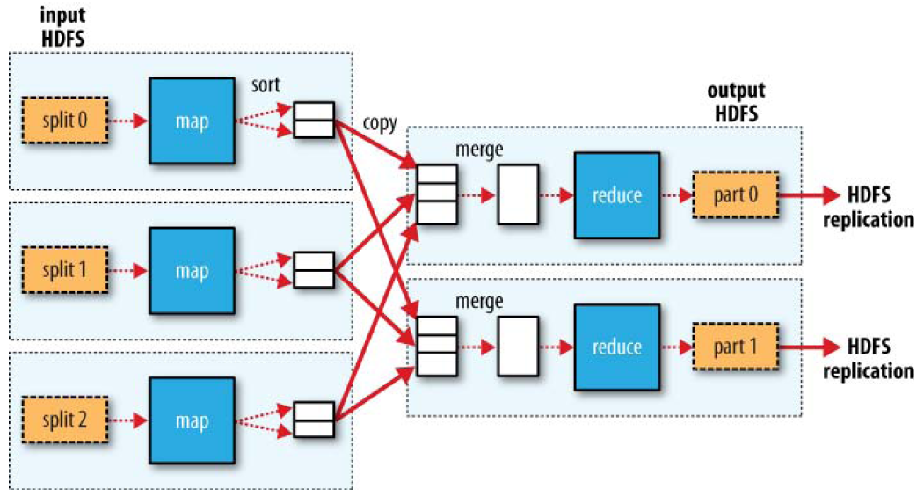
How Reduce Tasks Work – 1
Reduce tasks don’t have the advantage of data locality.
Input to a single reduce task is normally the output from all mappers;
Output of the reduce is stored in HDFS for reliability.

Slide 31
How Reduce Tasks Work – 2
The number of reduce tasks is not governed by the size of the input, but is specified independently.
When there are multiple reducers, the map tasks partition their output:
One partition for each reduce task.
The records for every key are all in a single partition.
Partitioning can be controlled by a user-defined partitioning function.

Slide 32
Combiner Function - 1
Combiner function
Can be specified by users and is run on the map output.
Forms the input to the reduce function.
Minimizes the data transferred between map and reduce tasks.
But Hadoop do not guarantee how many times it will call combiner function for a particular map output record.
It is just optimization.
The number of calling (even zero) does not affect the output of Reducers.
max(0, 20, 10, 25, 15) = max(max(0, 20, 10), max(25, 15)) = max(20, 25) = 25

Slide 33
Combiner Function - 2
Combiner Function

Slide 34
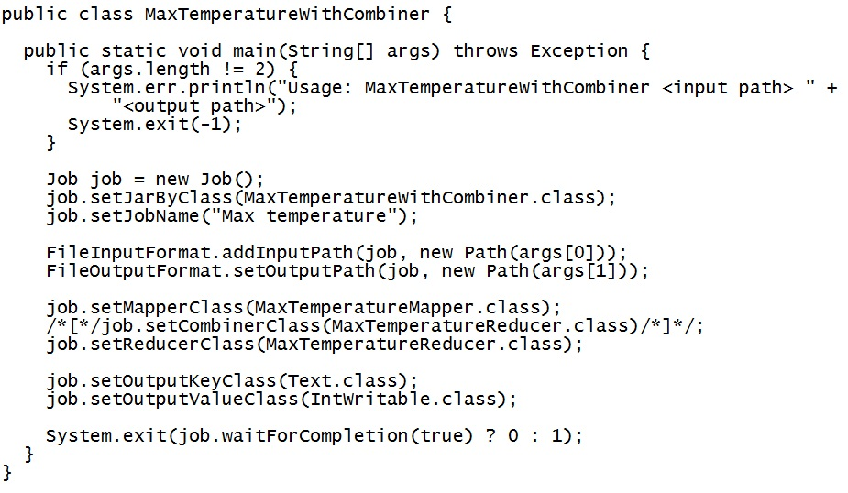
Combiner Function - 3
Combiner Function is defined using the Reducer class.
Just set the combiner class on the Job.

Slide 35
Hadoop Streaming and Pipes
Hadoop provides API for writing map and reduce functions in other languages (Ruby, Python,…).
The other languages must be able to read standard input and write to standard output.
Hadoop Streaming uses Unix standard streams as the interface between Hadoop and your program.
Hadoop pipes is the name of the C++ interface to Hapdoop MapReduce.
Uses sockets as the channel over which the tasktracker interacts with the process running the C++ map or reduce funtion.

